Slide 1
Health and Safety Guide
April, 2021
Environmental Safety Management Office, School of Science, The University of Tokyo

Slide 2
Contents
H & S Guide ⅰⅱ
1. Purposes of Safety Education
2. Safety Management System
Regulations on health and Safety that apply to the university, Organizational Chart, Safety Patrol and Regular Inspections, Safety Education
3. How to Prevent Accidents and Incidents
Confirmations, General Safety Practices, Waste Disposal
4. Emergency Procedures
Basics of Emergency Response, Response to Fire / Explosions / Chemical Leaks / Earthquakes,
Response to Accidents, AEDs
5. Office Safety Practices
6. Occupational Accidents / Accident Insurance for Students
7. Health Care and Consultation Services
8. Laboratory Safety Practices
General Safety Practices, Management of Hazardous Substances, Radiation and Radioisotopes, Biosafety, Dangerous Equipment and Personal Protective Devices, laboratory Waste
9. Education and Research Activities during Field Work
10. Electrical Apparatus and Facilities

Slide 3
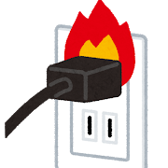
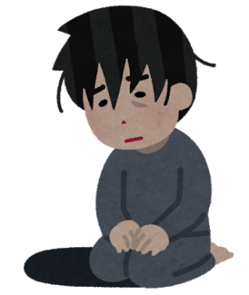
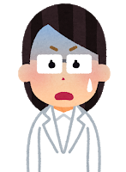
1. Purposes of Safety Education
The goals of the University of Tokyo, based on academic freedom, lie in the pursuit of truth, creation of knowledge, and maintaining as well as developing the highest level of education and research in the world.
(from “The University of Tokyo Charter”）
However・・・
- Poor physical condition
- A fire broke out in the laboratory
- The shelf collapsed due to the earthquake
It interferes with education and research.

Slide 4
An example of accidents happened in School of Science
The container of liquid nitrogen has fallen, 2016
Fire, 2016
(due to a short circuit in the power cable of the overnight working equipment in the fume hood)
A student carried the container alone.
The bent part of the power cable was damaged.
Fire, 2016
(Vaporized ether ignited. The experimenter got burns on both hands and face)
A student put chemicals at once by mistake.

Slide 5
理学部で実際に起こった事故例
Fire, 2017
(A fire broke out from the solution after inactivating the metallic sodium with alcohol.)
Fire, 2020
(A cardboard ignites due to forgetting to turn off the device.)
The inactivation was not enough.
Melting, 2020
(The plastic products in the room melted due to the abnormal heating of the aquarium heater. ）
A student working alone at night and reporting the accident next morning.
The unused equipment was not unplugged.

Slide 6
Purposes of Safety Education
H & S Guide p.1
Safety education helps us to take measures to prevent accidents, and to protect themselves from potential dangers, so that in order to ensure that safety is fully guaranteed throughout all educational and research activities.
These stipulations demand strict observance of the laws and regulations to prevent or minimize damage and maintain health in the event of accidents or natural disasters.
First, avoid accidents!
If it happens, take appropriate action to reduce the damage.

Slide 7
2. Safety Management System Regulations on health and Safety that apply to the university
Regulations that apply to all people
■ School Education Law Health Center was established to perform health check-ups etc.
■ Industrial Safety and Health Law
Environmental Safety Management Office was established to perform educations and patrols etc.
■ Fire Defense Law
Emergency Drill
Regulations that apply to certain users
Poisonous and Deleterious Substances Control Law
High Pressure Gas Safety Law
Laws Concerning the Prevention from Radiation Hazards due to Radioisotopes and Others
Pollutant Release and Transfer Register (PRTR)
etc.

Slide 8
H & S Guide p.2
2. Safety Management System Organizational Chart
Environmental safety management must be undertaken at all levels and in accordance with the structure of authority.
1. Responsibility of an employer for securing the health and safety of workers
2. In turn, an employee is obliged to comply with the health and safety measures taken by the employer.
Department
Head of Office
Dean
Head of Dept.
Laboratory Manager
Staff
Students
Researchers
President
Administration
Office
Office (ex. Hongo)
Safety Manager
Support/Guide
School of Science
Environmental Safety Management Office
Executive Vice President for Health and Safety
Health Center
Industrial Physician
- Environmental Science Center
- Isotope Science Center
- Research Center for Nuclear Science and Technology etc.
Support/Guide
Division for Environment, Health and Safety

Slide 9
H & S Guide p.2,3
2. Safety Management System Safety Patrol and Regular Inspections
Patrols and regular inspections shall be undertaken to prevent accidents, damage, and environmental pollution.
□ Patrols
Join the patrols and improve the indicated matters.
- Patrols by the Dean of the School
- Patrols by the Occupational Physician / health managers
- Patrols of important areas / critical points
□ Regular inspections
- Regular inspections to be executed at all Laboratories.
- Statutory inspections and report are specified for the following facilities. (ex. Localized ventilation equipment, X-ray irradiation equipment, pressure containers, gas detectors, centrifuge, autoclave, crane etc.)
- ESMO conducts collective inspections for some facilities.

Slide 10
2. Safety Management System Safety Education
H & S Guide p.3
The Industrial Safety and Health Law oblige all personnel to take safety and health education. (Article 59）.
The purpose of Safety Education:
To be aware of potential dangers and hazards associated with research activities and other operations
To learn how to protect ourselves from these hazards
The object / Timing:
All personnel in the university, including students must take Safety Education when first entering the School, employed by the office, and in the event of major changes in the operations.

Slide 11
Safety Education
Special Trainings
Persons conducting specific operations (changing grinding stones, arc welding, etc.) must participate in special training and lectures.
Staff and students using X-rays and radioactive materials (RI) must comply with the Radiation Safety Regulations of the School of Science, and must take the specified lectures.
Lectures and Practical Trainings
The University of Tokyo hold lectures and practical trainings to handle and maintain the chemicals or facilities.
Environmental Science Center: Practical trainings of chemicals etc.
Division for Environment, Health and Safety: Lectures of UTCRIS, centrifuge, ventilation equipment, autoclave etc.

Slide 12
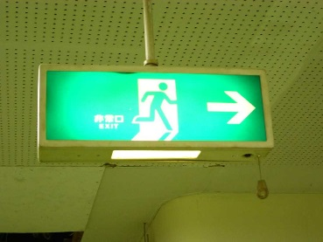
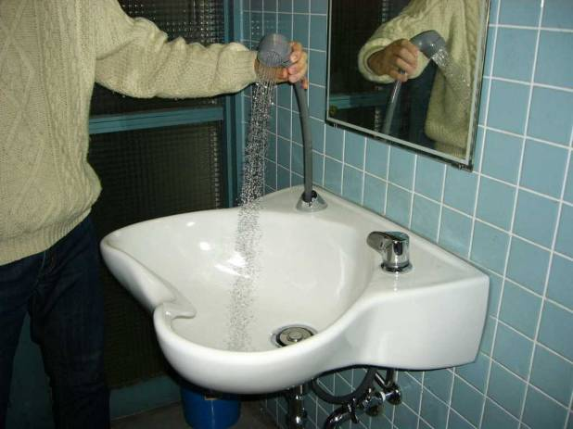
3. How to prevent accidents/incidents Confirmations
H & S Guide p.4
It is important to confirm the following information to prevent and respond to any possible disasters.
Contact information: Confirm the following Emergency telephone numbers. (ref. back of the manual)
- Mobile/home phone number of Laboratory manager - Disaster Prevention Center (School of Science): 03-5841-4016 - Fire/ Ambulance: 119
Evacuation routes: Evacuation routes, emergency exits, and evacuation areas.
Location and operation of equipment: Emergency showers, fire extinguishers, fire extinguishing sand, fire alarms and fire hydrants, leak preventions kits, megaphones, emergency broadcast speaker etc.
Emergency drill : Join the fire and evacuation drill.
In FY2021 Fire drill: May 19th Evacuation drill: October 15th

Slide 13
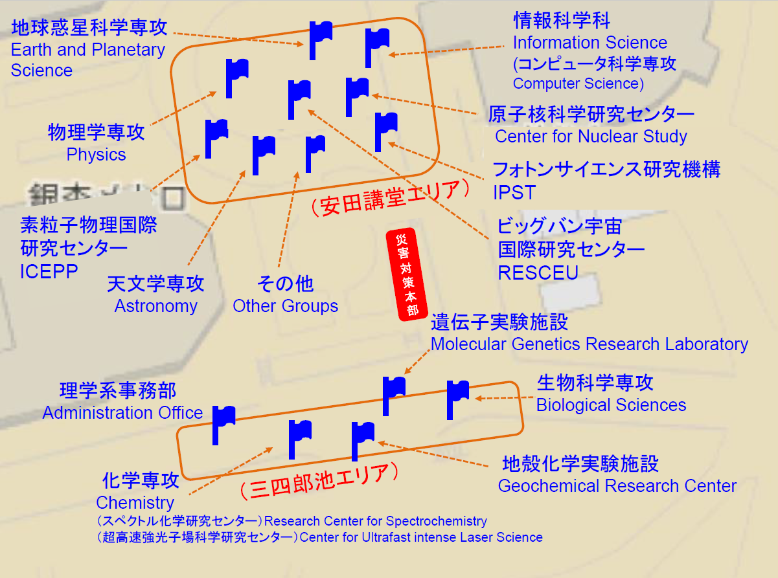
Evacuation Areas
H & S Guide p.26

Slide 14
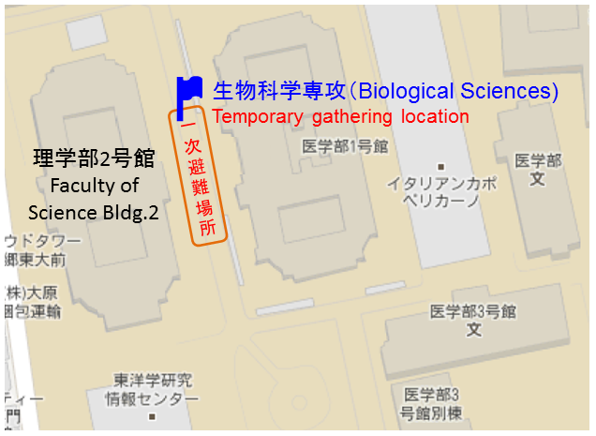
Evacuation Areas (Faculty of Science Bldg.2)
※Safety evacuation place: Sanshiro Pond Northern Area

Slide 15
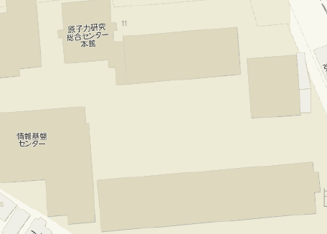
Evacuation Areas (Faculty of Science Bldg.3)
生物科学専攻（Biological Sciences)
一次避難場所
Temporary gathering location
その他
（Other Groups)
理学部3号館
Faculty of Science Bldg.3
※Safety evacuation place: Sanshiro Pond Northern Area

Slide 16
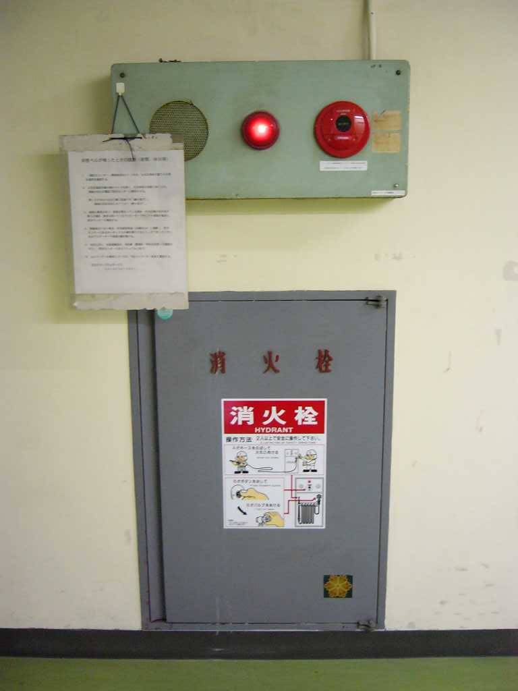
Fire-fighting facilities
H & S Guide p.4
fire alarms
fire hydrants
Fire extinguishers
Fire extinguishing sand

Slide 17
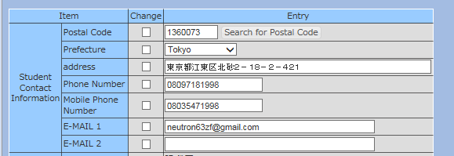
Safety Confirmation Service for Earthquake
H & S Guide p.4
Safety Confirmation Service
If a major earthquake (of seismic intensity 5 or more on the Japanese scale) afflicts the area where you live, work, or study, the Safety Confirmation Service will automatically send out an email. Please be sure to input your current information on the Personal Information System or UTAS.
＜Staff＞
①Employment Management → Personal Info
→ ③Login→ ④Personal Menu → ⑤Input to 「災害時安否確認用情報」
＜Students＞
①Login UTAS
→ ②Input Student Contact Info.
Input the e-mail address you can contact by portable phone or tablet
out of campus.

Slide 18
3. How to prevent accidents/incidents General Safety Practices : Common space
H & S Guide p.4
It is important to take the following daily precautions to prevent and respond to any possible disasters.
Windows, aisles, doors, corridors and emergency stairways must be free from obstructions in order to keep evacuation routes clear.
Do NOT put any obstacles in front of emergency exits, fire doors, or fire shutters.
Do NOT put any obstacles near fire extinguishers, fire alarms, or fire hydrants.
Do NOT remove fire extinguishers from their designated locations, except when using them. ※The locations are reported to Fire Department. They must not be removed.

Slide 19
3. How to prevent accidents/incidents General Safety Practices: Office and Laboratories
H & S Guide p.5
Always keep rooms and corridors tidy.
Do NOT allow any obstacles to block the routes. All evacuation routes must be 80-cm wide or more. Secure two evacuation routes when using hazardous materials.
Waste materials and chemicals must be correctly sorted for disposal according to the relevant rules.→Refer to ”Living Waste”
Security: - Room and laboratory doors should be kept closed. - Lock the door when leaving a room or a laboratory. - Do NOT lend your key (or ID card) to anyone else. When entering a locked building or room, do not allow anyone unknown to you to enter at the same time.
Anti-toppling measures: - Secure cabinets to the walls etc. - Prevent objects from falling off flat laboratory tables. - Use cabinets with double sliding doors to store chemicals. - Install railing for cabinet shelves.

Slide 20
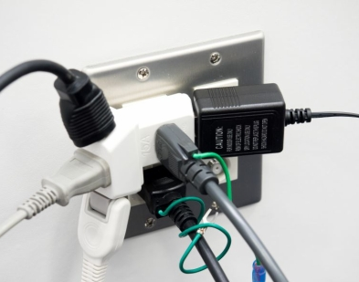
General Safety Practices: Office and Laboratories
Electricity: - Compare the power consumption to the capacity of the outlet in order to prevent overheating and current leakage. Do not use starburst connections. - Use standard products. - When leaving the workplace, turn off the power to all equipment except any that are required to operate overnight.
Combustibles:
- Use only safe heating equipment (e.g. shockproof quality), and do NOT place heaters near flammable substances or objects.
- Be aware that static electricity may ignite nearby combustibles.
- Equipment that uses naked flames must be placed on fire-proof stands.
- Smoking is only allowed in designated smoking areas.

Slide 21
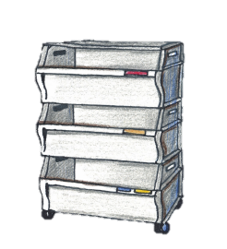
Chart for sorting wastes in daily life
H & S Guide p.5，24
Classification | Sorting |  | Important points | Place of discarding
Combustible | Combustible wastes |  | Garbage, paper cup, wooden chopsticks etc. | Cart for Combustibles
Non-combustible | Glass / Ceramics |  | Fragments must be put into transparent bag and box. | Cart for Non-combustibles
 | Other |  | Metal dust, rubber, aluminum foil, spraying can etc.
Recyclable | Paper | Newspaper / Copying paper / Magazine | Shredder dust (in transparent bag) is here. Staples do not have to be removed. | Recycling box
 |  | Cardboard | Bind with rope. | Recycling collection place
 |  | Confidential documents | Bring it directly to circulating shredder car. | Circulating shredder car
 | Beverage can |  | Empty the can. Cans for snacks are here. | Cart for beverage cans
 | Glass bottle |  | Beakers and fragments are non-combustible waste. | Cart for Glass bottles
 | PET bottle |  | Empty the bottle. Lid and label are Plastics. | Cart for PET bottles
 | Plastics |  | Lunch tray (leftover is combustible wastes.), plastic bags, CD-ROM etc. | Cart for Plastics

Slide 22
H & S Guide p.6
4. Emergency Procedures Basics of Emergency Response
In the event of a disaster, the most important thing is to ensure your own safety and act in an appropriate manner in accordance with the scale of the emergency.
Ensure your own safety
Alert others and report
Take necessary measures (put out fires / help others)

Slide 23
Report also your lab’s staff!
H & S Guide p.6
4. Emergency Procedures Response to Fire
Outbreak of Fire
Notify people of the outbreak of fire
(Call for assistance and press the fire alarm button)
Call 119 and
contact Disaster Prevention Center
(03-5841-4016)
Commence initial
fire-fighting activities
Note: Evacuate immediately if you sense danger
Unintentional fire is ‘Fire’.
In radioactive facilities: Also contact the RI Management Office (03-5841-4606).
Move radioactive materials to their storage site.
- Disaster Prevention Center broadcasts to everybody in the affected & adjoining buildings.
- The building’s fire-fighting group will take charge of activities.
- Try to put out the fire with appropriate fire extinguishers.
- If the flames are higher than your head, evacuate immediately.
Evacuate to the Designated Evacuation Area
Make the Decision to Evacuate: University staff will make the decision and broadcast that people must evacuate, but evacuate immediately if you sense danger.
Confirmation when Evacuating:
- Cover your nose and mouth with cloth.
- Close all fire doors to prevent the fire from spreading.
- Do not use the elevators.
- Help those who have a disability.
Confirmation before Evacuating:
- Check the surroundings and assist anyone trapped, locked in, or injured.
- If unable to help others, contact the Disaster Prevention Center.
【 Safety Confirmation 】- Follow the instructions of faculty members and administration staff. - The manager of the office or laboratory must check the safety of its members and report it to the affiliated department office.

Slide 24
There was a delay in reporting the accidents in 2020
Response to Fire
If there is no fire but smoke or something melted, or in case of successing to put out the fire, please call 119 and Disaster Prevention Center for sure.

Slide 25
H & S Guide p.7
4. Emergency Procedures Response to Explosions / Chemical Leaks
Response to Explosions
• Check the surroundings and assist anyone who has been injured.
• Contact the Disaster Prevention Center immediately.
• Immediately secure the device that caused the explosion to prevent further hazard. If there is a danger of a further explosion, evacuate the premises immediately.
• There is a risk of secondary accidents nearby due to shock waves or flying debris, so be sure to check the surroundings in addition to the source of the explosion.
• In the event of a fire, take necessary measures as per “4.2 Response to Fire”.
Response to Chemical Leaks
• If the chemical is highly toxic, inform the people around you and evacuate the premises immediately.
• If possible, stop the leak and prevent it from spreading.
• In the event of large quantities of acid entering the sewers, contact the Waterworks Bureau (03-5343-6209 for Hongo Campus) directly.
• In any case, contact the Disaster Prevention Center immediately.

Slide 26
H & S Guide p.8
4. Emergency Procedures Response to Earthquakes
Earthquake /
Early Earthquake Warning
Do not move around while it is still shaking
Ensure your own safety (Protect your head)
Open doors to secure evacuation routes
- Extinguish all gas burners and other equipment that use naked flames.
- When hazardous materials are in use, cap the bottles and take all safety measures.
- In radioactive facilities, move radioactive materials to their storage site.
- Look out for any secondary threats to prevent the disaster from escalating.
- University staff are to cease all lectures, experiments, examinations and meetings if there is a threat of danger.
Once the shaking stops, Evacuate to the Designated Evacuation Area
Make the Decision to Evacuate: University staff will make the decision and broadcast that people must evacuate, but evacuate immediately if you sense danger.
Confirmation when Evacuating:
- Protect yourself from falling glass, etc. with a helmet or other article.
- Beware of injury from falling or toppling objects.
- Do not use the elevators.
- Help those who have a disability.
Confirmation before Evacuating:
- Check the surroundings and assist anyone trapped, locked in, or injured.
- If it is difficult to help others, contact the Disaster Prevention Center (03-5841-4016).
- Check to make sure fire has not broken out.
→ In case of fire, commence initial fire-fighting activities. Evacuate if the flames are higher than your head.

Slide 27
H & S Guide p.9
4. Emergency Procedures
Response to Earthquakes
Safety Confirmation
• Follow the instructions of faculty members and administration staff members.
• The manager of the office or laboratory must check the safety of members and report it to the affiliated department office.
• In the event of large earthquakes while outside the university, report on your safety to the manager of your office or laboratory. If you go to a different evacuation place or hear information about other members, share the information with your managers.
• When you receive an email from the Safety Confirmation Service, please reply to it as soon as possible.
Other Important Information
• If it is difficult to return home, you can stay at the university. The School of Science can make some rooms available as a temporary shelter, and provide water, food, blankets, and toilet facilities, etc.
• Use the disaster message dial (171) in order to confirm the safety of your family and friends.

Slide 28
4. Emergency Procedures Response to Accidents
H & S Guide p.10
See the back of the Guide
In the event of an accident, injury or illness,
① Contact the hospital or Fire Department as appropriate based on the situation.
② Contact Disaster Prevention Center immediately.
③ Report the details to the manager of the office/laboratory, the department office, and ESMO.
④ After discussion with the person concerned and the manager of the office/laboratory, submit a report on the accident via the online University of Tokyo’s Safety Management & Information System (UTSMIS).
Person concerned / People around
Hospital / Fire Department
①
④
③
②
Manager
UTSMIS
Department Office
Disaster Prevention Center
ESMO

Slide 29
H & S Guide p.10
4. Emergency Procedures Automated External Defibrillators (AEDs)
AEDs are cardiopulmonary resuscitator units that revive people whose hearts have stopped beating.
If you find someone lying prone:
(1) Tap them on the shoulder and speak to them.
(2) If there is no response, shout for help and ask passersby to call 119 and bring an AED unit.
(3) Check the person’s respiration – i.e. Are they breathing?
(4) If respiration is normal, immediately commence with 30 chest compressions (heart massage).
(5) After the chest compressions, perform artificial respiration twice.
(6) When the AED unit arrives, first of all switch on the power. Then following the audio instructions provided.
Students, faculty, and administration staff at the University of Tokyo can participate in regular lectures held by the Fire Department. The lecture is provided during the evacuation drill.

Slide 30
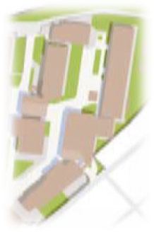
H & S Guide p.27
Map of AED locations for the
Faculty and Graduate School of Science
Disaster prevention center (Faculty of Science Bldg.1)
Koshiba Hall
(Faculty of Science Bldg.1)
Entrance Hall
(Chemistry Main Bldg.)
Faculty of Science Bldg.1, Chemistry Bldg
Janitor's room
Entrance Hall
(Faculty of Science Bldg.3)
Faculty of Science Bldg.2
Faculty of Science Bldg.3 (Asano Area)

Slide 31
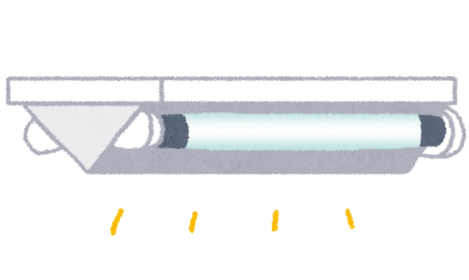
H & S Guide p.11
5. Office Safety Practices VDT: Preventing Eye, Neck and Arm Strain
VDT Operation: The operation using Visual Display Terminals
Arrange the office lighting environment so that the lights are not reflected from the screen.
Wear lenses that best suit you.
Maintain at least 40cm distance between the eyes and the screen.
Sit back in the seat, and stretch the back along the backrest.
Use eye drops and wrist rests if necessary.
Choose a chair with high stability.
The height of a chair＝operator’s height×0.23
Maintain elbows at 90 degrees or more.
Take a rest of 10 to 15 minutes after an hour of work.
Do VDT or physical exercises.

Slide 32
H & S Guide p.12
5. Office Safety Practices Preventing Backache
When Lifting a Heavy Object
When Engaged in Deskwork
Position the work items so that you can use them while maintaining a natural posture.
Stand up and stretch your back occasionally.
Daily Precautions
Do physical exercises to maintain abdominal and back muscle condition.
People should not lift more than 40% of their own bodyweight.
Bend your knees, crouch down and hold the object firmly, then slowly straighten your knees and stand up.
✔
Use stands of appropriate height in order to reduce operations that require bending your back.
When carrying a heavy object, keep your back straight and avoid twisting.

Slide 33
H & S Guide p.13
6. Occupational Accidents
Definition of occupational/Commuting Accidents
Occupational accidents refer to injuries, illnesses, disabilities, or deaths that occur at work. The accidents while commuting to or from work are handled similarly.
Requirements for Recognition
Engaged in task: The employee was under the employer’s supervision/instruction.
Origin of task: The employee incurred the injury etc. while fulfilling his/her job description.
Compensation
Actual payment of medical fees and compensation for absence from work
Disability payment, or payment to the bereaved in the event of death
Applying for Compensation
Submit the Accident Report and obtain an employer certificate from the department office.
The person who suffered injury etc. or his/ her family must apply at the Labor Standards Inspection Office.
If the accident is under special circumstances such as during work-breaks, or deviations while commuting, ask department office.

Slide 34
H & S Guide p.13
6. Accidents Insurance for Students
Definition of ‘GAKKENSAI’
“Gakkensai” is Personal Accident Insurance for Student pursuing Education and Research. This program pays benefits to you in the event of an accident while engaged in educational or research activities and commuting to the university.
All the students of UTokyo are automatically enrolled in Type A with commuting coverage at university expense.
Covered students
Undergraduate Student, Graduate Student, Research Student, Auditor, Special Auditor, Specially Registered Student, Special Research Student, JSPS(PD)
Applying for compensation
In the event of being involved in an accident, contact Department Office and Tokio Marine & Nichido, insurance underwriting company.
For more information, refer to brochure or website of JEES.
This insurance does not cover the illness or liability insurance.

Slide 35
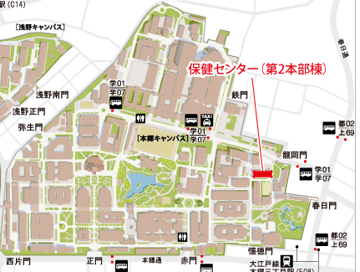
7．Health Care and Consultation Services
H & S Guide p.14
Medical check-up
Employees are obliged to maintain good health.
Employees and students must take the examinations provided by the university.
There are special health examinations for people engaged in hazardous jobs.
Faculty members are obliged to comply with health instructions following health examinations..
Hongo Health Service Center
(in Adm. Bureau Bldg.2)
Dust, Lead, Organic solvent, Specified chemical substances, radiation etc.

Slide 36
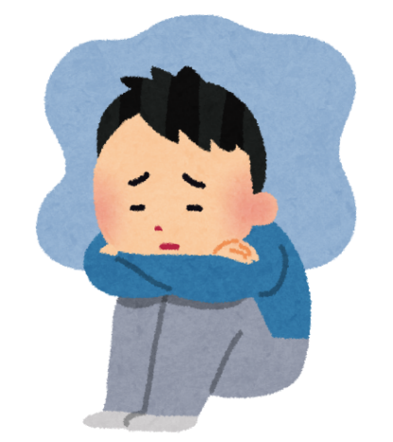
7．Health Care and Consultation Services
H & S Guide p.14
Mental Health
Harassment
If you have concerns about your mental health, you may seek assistance from the following services:
○Industrial physician （ext.28429、03-5841-8429）
○Division for Health Service Promotion （ext.22578、03-5841-2578）
○Student supporting room of the School of Science
（Faculty of Science Bldg.1. Room No. 132, ext.28296）
Insomnia, Feeling having not had enough sleep
waking up at night or early in the morning
Not feeling like doing anything
Feeling a sense of disinclination toward work / school
If you have concerns about harassment, you may seek assistance from the following services: ○Harassment Consultation Center （ext.22233, 03-5841-2233）
○Harassment Counselors, School of Science (Enquire at the department office)

Slide 37
H & S Guide p.15
8. Laboratory Safety Practices General Safety Practices
Principles of Safety Management
• Safety Data Sheets are useful for obtaining information on a substance.
• If you plan to use an extremely hazardous material, you must consider using a less hazardous alternative.
Learn about the potential hazards of substances and equipment. Check applicable laws and regulations.
Establish safety measures to avoid creating potential hazards.
Carry out laboratory work with adequate safety measures.

Slide 38
H & S Guide p.15
8. Laboratory Safety Practices General Safety Practices
Precautions during Experiments
Keep the laboratory clean and uncluttered at all times.
Do not leave unnecessary chemicals on the laboratory bench. Do not leave chemical containers unattended on the floor.
Choose and wear appropriate protective devices such as protective goggles, gloves, white lab coat etc. appropriate for the experiment.
In general, do not carry out dangerous or hazardous experiments during the weekend or after-hours. Such experiments must be attended by more than one person.
Know the location of emergency exits, as well as the location, type and handling of fire extinguishers in case an accident occurs.
Ensure that all the precautions that are required for unattended machine operations are in place, and display emergency contact numbers near the entrance of the laboratory or where clearly visible.
When carrying out experiments, always adopt a serious attitude. The accidents occur because familiarity with the operation leads to reduced attention.

Slide 39
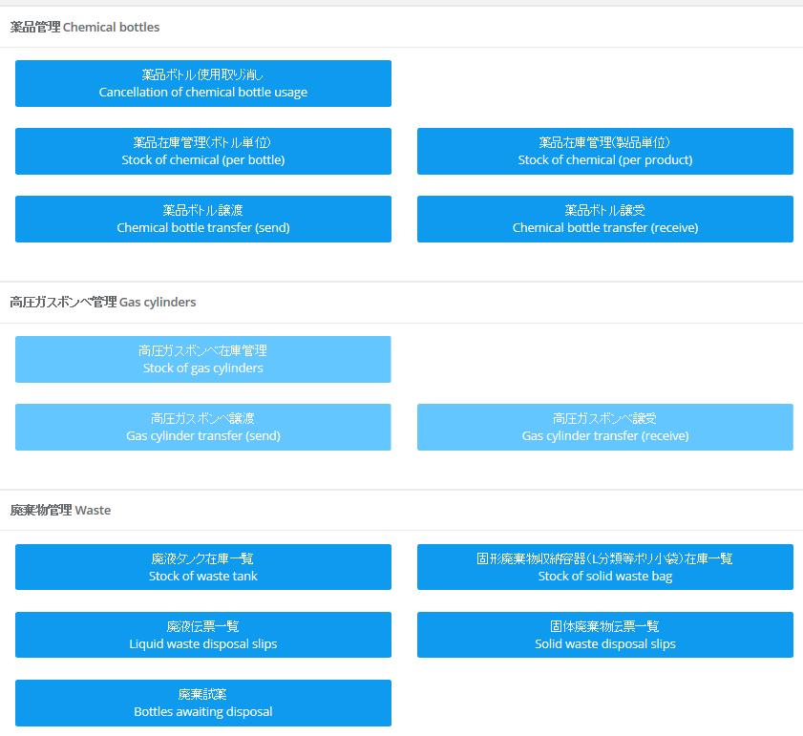
H & S Guide p.16
8. Laboratory Safety Practices Management of Chemical Substances / Hazardous Substances
Management Systems for Chemical Substances
The chemical substance manager from each laboratory must take the central role in chemical substance management with regard to health and safety.
The quantity of each chemical substance and high-pressure gas must be managed in accordance with the Chemical Information Management System (UTCIMS, start in 2020). This system ensures that chemical substances are managed comprehensively and the various regulatory requirements of the law.
If you have any question, refer to the manual of UTCIMS or contact ESMO.

Slide 40
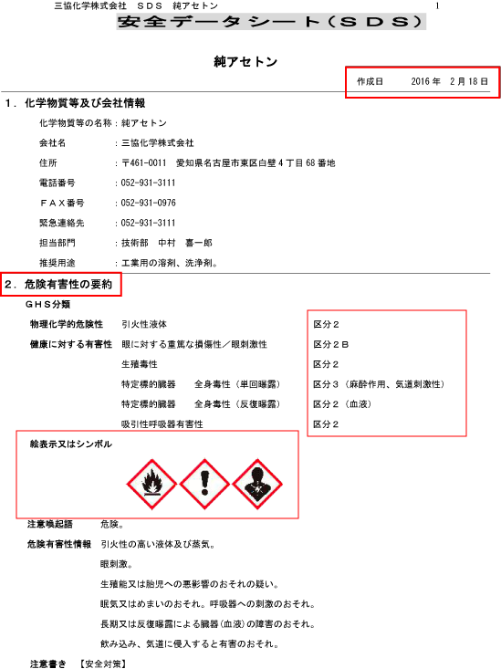
H & S Guide p.16
8. Laboratory Safety Practices Management of Chemical Substances / Hazardous Substances
Safety Data Sheet (SDS)
Before handling a chemical substance, information on the toxicity, flammability and explosiveness of the substance must be obtained by consulting the SDS.
SDS is provided by the manufacturer or distributor of the substance.

Slide 41
H & S Guide p.16,17
8. Laboratory Safety Practices Management of Chemical Substances / Hazardous Substances
Hazardous Substances and Legal Regulations
Before handling a chemical substance, determine whether it is regulated by law.
The handling and storage of hazardous substances written in the right box are regulated by law. Refer to the ESMO website to handle them safely.
If a specific procedure is required by law, consult the ESMO for directions.
Potentially hazardous chemical substance and chemical wastes must be treated with sufficient safety measures, even if they are not regulated by law.
1) Organic solvents: OPOSP
Specified chemical substances: OPHSCS
Poisonous substances: Poisonous and Deleterious Substances Control Law
Deleterious substances: Id.
Narcotics: Narcotics and Psychoactive Drugs Control Law
Psychoactive drugs: Id.
Stimulants: Stimulants Control Law
Chemical substances regulated by PRTR Law
Hazardous substances: Fire Services Law
High-pressure gases: High-pressure Gas Safety Law
Radioisotopes (RI)
Biohazardous materials

Slide 42
H & S Guide p.17
8. Laboratory Safety Practices Management of Chemical Substances / Hazardous Substances
Precautions for Handling Hazardous Substances
Any person handling hazardous substances must be educated on them and fully understand the nature of the substance.
Before using hazardous substances
Efforts to minimize the use of highly hazardous substances must be taken when drawing up the study protocol. Consider whether it can be substituted with another substance.
Consider and prepare thoroughly to prevent disasters caused by the substance. - The potential to cause a fire: Place extinguishers nearby and wear heat resistant clothing. - The potential to cause poisoning: Wear rubber gloves, protective mask and clothing.
Using hazardous substances
Before conducting a hazardous experiment, inform the people nearby, and take appropriate safety measures.
Use the least possible amount of hazardous substances, and if the nature of a substance is unknown, a preliminary experiment must be conducted.
Open the ampoules of hazardous liquids in a sealed container to prevent being spilled.
Hazardous substance must not be disposed of with non-hazardous wastes. Refer to “Laboratory Waste” when you dispose chemical substances.

Slide 43
H & S Guide p.18
8. Laboratory Safety Practices Management of Chemical Substances / Hazardous Substances
Precautions for Handling Hazardous Substances (Rest)
Surrounding condition
Do not use an open flame heater in a laboratory where a volatile solvent is used.
Know the locations of extinguishers. If there is a risk of fire, ensure that a fire extinguisher is close to the work area.
Turn off the main valve of the gas supply whenever no one will be staying in the room.
Storing hazardous substances
Inspect the storage conditions and quantities of hazardous substances.
Use a solid container and with a cap or stopper that will prevent the substance spilling, leaking or evaporating. During storage, ensure the containers are closed.
Store them in a cool place and away from direct sunlight and ignition sources such as sparks. Do not store substances with different characteristics in the same location.
Ensure that stored containers cannot be damaged as a result of falling over or colliding, even during an earthquake. Store hazardous substances separately.
If they are missing or stolen, it must be reported to the chemical substance manager.

Slide 44
H & S Guide p.18
8. Laboratory Safety Practices Management of Chemical Substances / Hazardous Substances
Management Required by Regulations：Organic Solvent (OPOSP) / Specified Chemical Substances (OPHSCS)
[Managing the Work Environment]
Preventing vapor and dust discharge (use a fume hood)
Assessing the work environment (twice per year)
[Managing Work Procedures]
Establishing safe work procedures
Using personal protective equipment
[Health Management]
Understanding measures to prevent sickness, and knowing first aid
Undertaking specialized medical checkups (twice per year)
[Others]
Signs and displays referring to the substances being used, and precautions
Assessment will be operated on the basis of the quantity examination of chemical substances by UTCIMS in every quarter. ESMO will contact each laboratory through the department office.
If it has come to a bad condition, an investigation and reassessment will be conducted. The experiment might be stopped when the condition has not improved. Work to maintain a safe environment!

Slide 45
H & S Guide p.19
8. Laboratory Safety Practices Management of Chemical Substances / Hazardous Substances
Management Required by Regulations： Poisonous and Deleterious Substances / Narcotics and Psychoactive Drugs / Stimulants Control Law
Before buying, importing, receiving, or preparing the Poisonous and Deleterious Substances / Narcotics and Psychoactive Drugs / Stimulants, an application in advance and the license is necessary. Be careful not to buy or receive them casually.
Store the substances separately from other chemicals in a locked cabinet.
Use UTCIMS to manage the quantity of all substances purchased, used, or disposed of.
Use protective equipment as needed when handling such substances.
For poisonous and deleterious substances, cabinet must be labeled.
Lock, please!
For narcotics, psychoactive drugs or stimulants, a notification is necessary whenever the researcher moves to another site, the storage place is changed, or they are disposed of.

Slide 46
H & S Guide p.19
8. Laboratory Safety Practices Management of Chemical Substances / Hazardous Substances
Management Required by Regulations： Fire Services Law (Hazardous Materials)
Ensure that stored containers cannot be damaged as a result of falling over, falling from the shelf, or colliding. Substances that are potentially hazardous when mixed (e.g., a combination of an oxidizing substance with a flammable substance) must not be stored in the same location.
When substances are stored at one fifth or more of the maximum quantity specified by law, this situation must be reported in accordance with the law.
In the storage or handling area, possible ignition sources must be strictly controlled and fire-fighting equipment must be installed.
Use appropriate protective equipment, such as goggles and shields, in order to ensure personal safety.
（東京理科大資料より）

Slide 47
H & S Guide p.20
8. Laboratory Safety Practices Management of Chemical Substances / Hazardous Substances
Radiation and Radioisotopes (RI)
Handling radiation includes using particle accelerator facilities, X-ray diffractometer and electron microscopes.
It is obligatory to observe “the Radiation Hazard Prevention Policy at the School of Science” and “the Rules for Managing Scientific X-Ray Machines”.
Procedures
Radiation Management Office, Faculty and Graduate School of Science
Tel: ext. 24606, 03-5841-4606 Fax: 03-5841-1363
E-mail: ri-kanri@chem.s.u-tokyo.ac.jp
Web：http://jimubu.adm.s.u-tokyo.ac.jp/inside/index.php/Ri
※People who need to use only A or B category X-ray machines is exempt from 2.check-up.
1. Apply for registration to acquire Authorization to Handle Radiation.
2. Undergo a health check-up for radiation handlers.
People who need to use radioactive facilities outside the School of Science must submit a certificate, issued at your request by Radiation Management Office.
3. Take safety courses at Isotope Science Center.
4. Take safety courses at the School of Science.

Slide 48
H & S Guide p.21
8. Laboratory Safety Practices Management of Chemical Substances / Hazardous Substances
Biosafety
Research which request ethical approval and which need to satisfy legal compliance: experiments with genetic modification, animals, specific pathogens, or using human ES cells e.g.
In case of conducting research and experiments concerned, refer to the following website to take necessary measures and attend the related lectures.
About biosafety matters such as submitting paperwork to the Dean in Faculty of Science, contact Research and External Fund Support Team (Tel: ext. 28084, E-mail: kenkyu-s.s@gs.mail.u-tokyo.ac.jp).
Office for Life Science Research Ethics and Safety, the University of Tokyo
Tel: ext. 21580, 03-5841-1580
E-mail: lifescience.adm@gs.mail.u-tokyo.ac.jp
Web：http://lsres.adm.u-tokyo.ac.jp/

Slide 49
H & S Guide p.21
8. Laboratory Safety Practices Management of Chemical Substances / Hazardous Substances
Risky Equipments
When using equipment that involves extreme temperature, pressure, voltage, speed or weight, implement protective measures and handle the equipment with care.
When handle them first time, take extra preparations and examine each part . Seek expert advice before use.
All equipment must be properly cleaned at the end of each experiment. If any defect is found, repair it or report it to the next user.
Keep the work area organized to avoid unnecessary noise, vibration and odor.
Personal Protective Devices
Protective device must always be ready for use, and share the information of the locations of it.
All personnel must receive training to use it correctly.
Take care to maintain it clean after use.
Protective Devices
1. For safe
Helmet, Safety belt, Safety shoes, Face shield, Rubber gloves etc.
2. For health
Dust mask, White robe, gloves, Protective eyewear, Earplugs, Rubber gloves etc.
There are various devices for use. Ready and wear appropriate ones depending on the condition of experiments.

Slide 50
H & S Guide p22
Laboratory Waste
Proper disposal of wastes
University does not generate pollution to continue research and education.
Treatment at the starting point
Individual
Laboratory
Treatment at the lower part of waste disposal stream is difficult
・Contents are indistinguishable
・Mixture of substances increases
risks and reduces the efficiency
of treatment
Department
University
The generators of wastes should separate them appropriately.
Waste-disposal company
Waste treatment stream in the university

Slide 51
Classification of wastes
1) Recyclable
2) Flammable material
3) Nonflammable material
4) Wastes that contain hazardous substances
I.Wastes in daily life
1) Hazardous chemical substance
2) Biological wastes
3) Pseudo infectious wastes
4) Radioactive wastes
5) Waste gas
6) Other experimental wastes
II. Experimental wastes
III. Medical wastes
IV. Drainage

Slide 52
H & S Guide p.22, 25
8. Laboratory Safety Practices Management of Chemical Substances / Hazardous Substances
Information of laboratory waste collecting in School of Science:
Liquid / Solid waste
- Frequency: Once per week
- Dispose under “Classification chart of chemically hazardous waste”. Waste generator must receive a lecture of Environmental Science Center to obtain the qualification.
- Contact (to request plastic containers and manifest slips): Accounting section, ‘Kanrigyomu’
(E-mail: keiri-k.s@gs.mail.u-tokyo.ac.jp)
When carrying the liquid waste, cap the container tightly so that not to leak.
Waste reagent
- Waste reagent which remains in the bottle at the time of purchase or name is clear
- Frequency: twice per year, offer the amount to ESMO in advance.
- Contact: ESMO (Tel: ext. 28868, E-mail: kankyo.s@gs.mail.u-tokyo.ac.jp)

Slide 53
8. Laboratory Safety Practices Management of Chemical Substances / Hazardous Substances
Waste contains mercury (include dry cells and fluorescent lamps)
- Frequency: 4 times per year, offer the amount to department office in advance.
- Contact: Accounting section, ‘Kanrigyomu’ (E-mail: keiri-k.s@gs.mail.u-tokyo.ac.jp)
Bulk waste
- Frequency: Once or Twice per year, offer the amount to department office in advance.
- It is necessary to confirm that chemically hazardous substances are not included.
- Refrigerators and air-conditioners:
→ For family use: In case of under “Act on Recycling of Specified Kinds of Home Appliances”, The university collects them.
→For professional use: Contact the dealer or maker to collect and recycle appropriately.
- Contact: Accounting section, ‘Chotatsu’ (E-mail: keiri-c.s@gs.mail.u-tokyo.ac.jp)

Slide 54
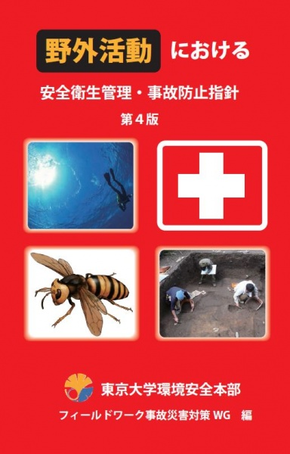
H & S Guide p.23
9. Education and Research Activities in the Field Work
Field Activities:
fieldwork, field observation, surveys using observation boats, field practice for students, field excursions, etc.
Because there are several other dangers during field work that differ from indoor work, read and carry “Prevention Policy for Accidents during Field Work” booklet , which is distributed to relevant laboratories.
Until one week before performing the filed work “Health and Safety Management Plan during Field Work” must be submitted to ESMO.
For further information, refer to ESMO Website:
http://jimubu.adm.s.u-tokyo.ac.jp/inside/index.php/outdoor

Slide 55
H & S Guide p.23
10. Electrical Apparatuses and Facilities
Mishandling of electrical apparatuses and facilities (wiring, table taps etc.) may cause electric shocks, fires due to overheating, or ignition of flammable gas by a spark.
- Experiencing a shock on touching
- Change in color or abnormally warm cable
- Foul odors or strange sounds
Most of accidents can be prevented by regularly checking the following:
Damage to outer sheath of electrical cables: Replace if the outer sheath exposed the wire when the cord is bent.
Loose screw: Use an insulated screwdriver to check the screw is firmly tightened.
Ground wire: Be careful to earth the apparatus again when moving it.
Check the equipment is not submerged, and the cables are not buried under heavy equipment.
Self-inspections of protective devices must be conducted at least once every 6 months.
Use a earth-leakage circuit breaker. Use appropriate thermal relays and motor protection relays for especially large motors.
About 40% of fire accidents in UTokyo are related to electricity!
It is very dangerous situation due to a leakage or overcurrent of electricity, or defective insulation. Cease use immediately and contact a specialist
If you find the old one, change to new.

Slide 56
Thank you for your cooperation on safe and health to continue the work and research.
Contact：
Safety Manager, Department of **
Room **, Faculty of Science Bld.*
E-mail： ＊＊＊＊@＊＊＊＊.u-tokyo.ac.jp
Tel: 03-5841-＊＊＊＊（ext.＊＊＊＊＊）
Environmental Safety Management Office, School of Science
Room 103, Faculty of Science Bld.1, West Area E-mail： kankyo.s@gs.mail.u-tokyo.ac.jp
Tel: 03-5841-8868（ext. 28868）
URL: http://jimubu.adm.s.u-tokyo.ac.jp/public/index.php/Esmo

